Slide 1
Shots And Camera Angles
Camera Composition

Slide 2
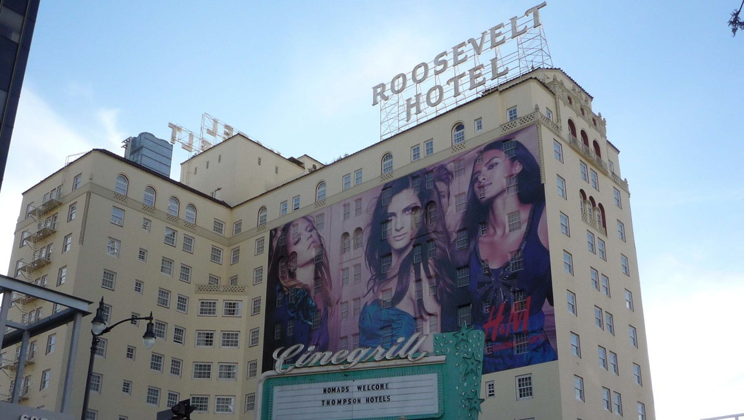
Establishing Shot
Lets the audience know where the next scenes are taking place. Gives us context

Slide 3
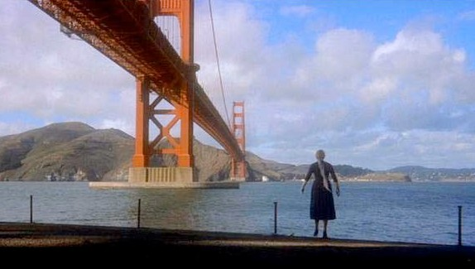
Long Shot
Gives us a view of the whole set with a large depth of field. Things are large in the foreground, and small in the distance.

Slide 4
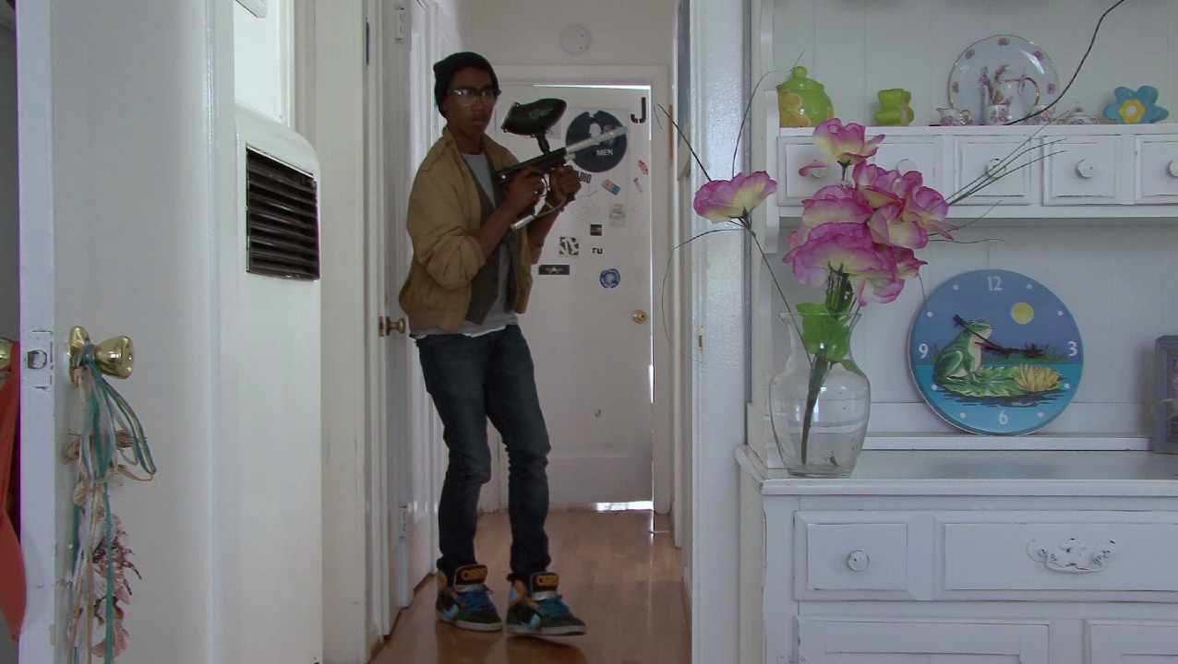
Full Shot
Entire body in frame

Slide 5
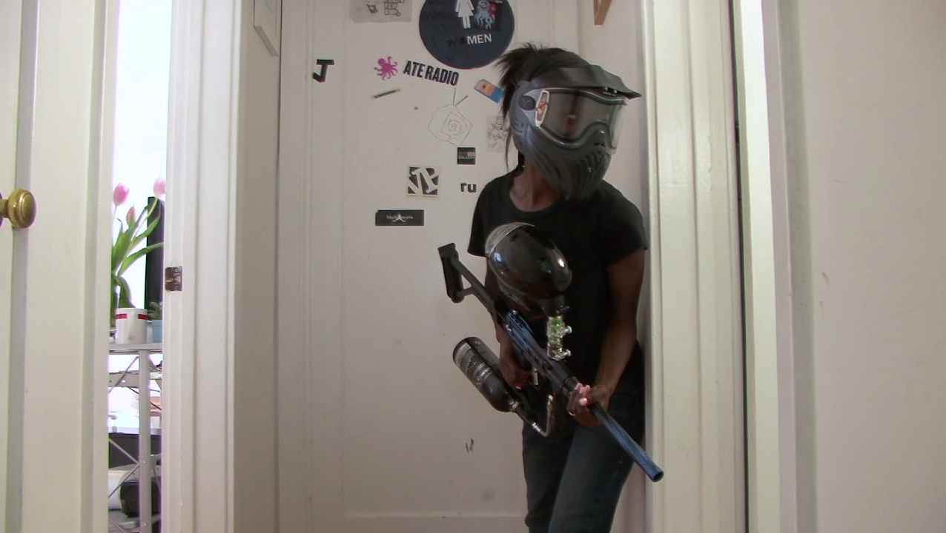
3/4 Shot
¾ of body in frame

Slide 6
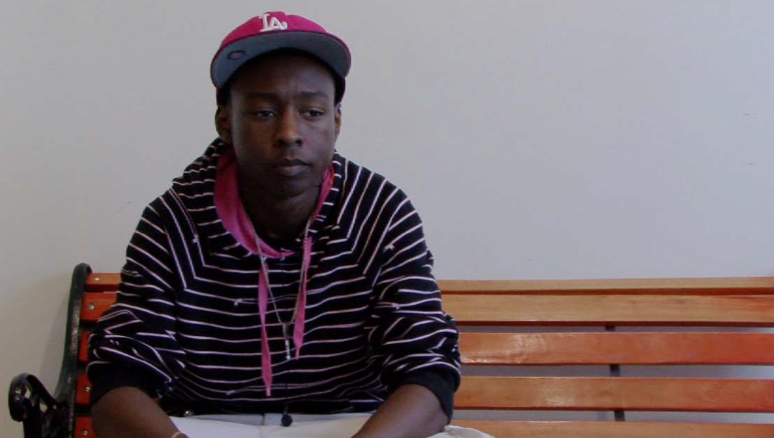
Medium Shot
½ of body in frame

Slide 7
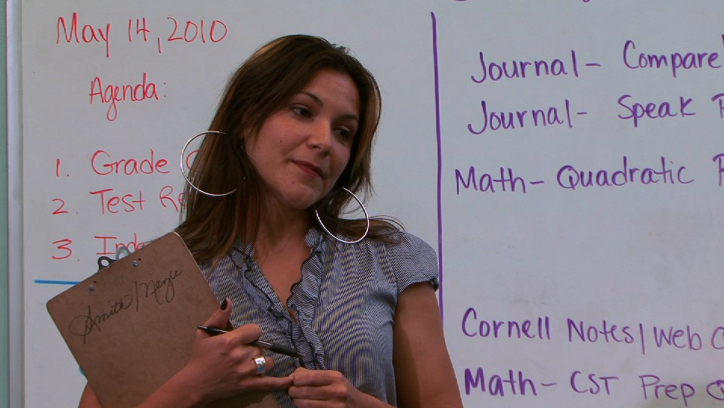
Medium Close Up Shot
Aka MCU

Slide 8
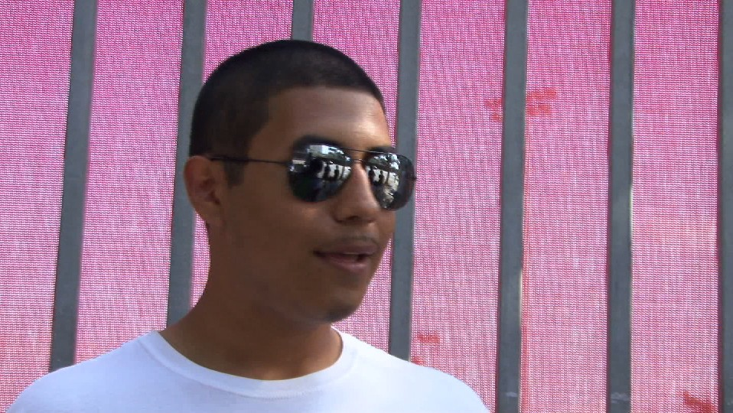
Close Up Shot
Aka CU

Slide 9
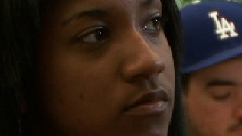
Extreme Close Up Shot
Aka ECU

Slide 10
Two Shot
Two Subjects In Frame

Slide 11
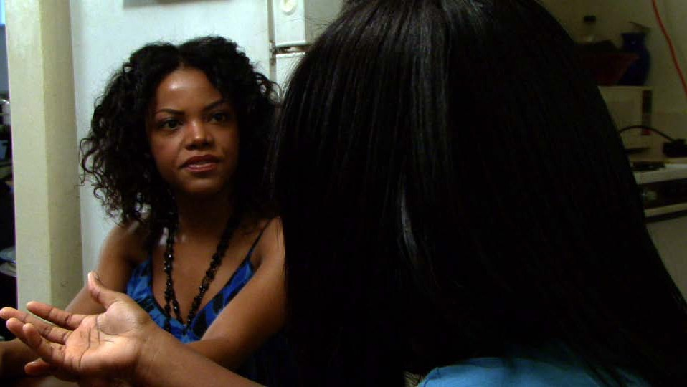
Over The Shoulder Shot
AKA OTS

Slide 12
Angles

Slide 13
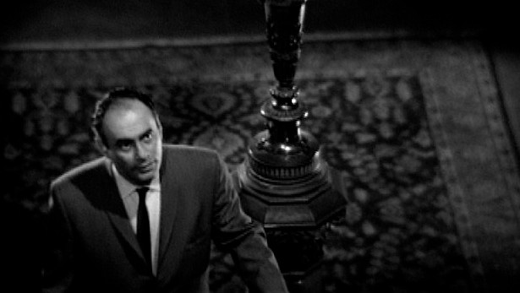
High Angle
From above, looking down. Makes the subject look weak, afraid or inferior.
Here, the actor is hesitant to go up the stairs, he fears danger at the top.

Slide 14
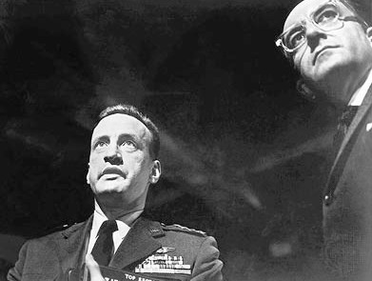
Low Angle
From below, looking up. Makes the subject look larger than life, dramatic, important.

Slide 15
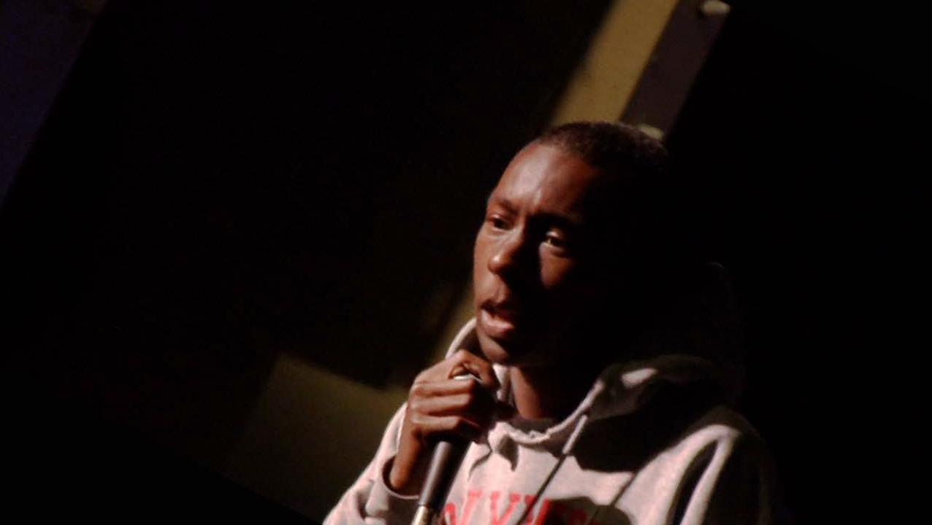
Oblique Angle
a.k.a. Dutch angle - Tilted horizon. Makes the scene seem off, not right. Villians are often shot with an oblique angle

